Slide 1
FAMOUS CANADIANS OF THE 1950s

Slide 2
Athletes
Sports in the 1950s were very popular, especially because of the cold war.
Athletes were infamous, and were treated like celebrities

Slide 3
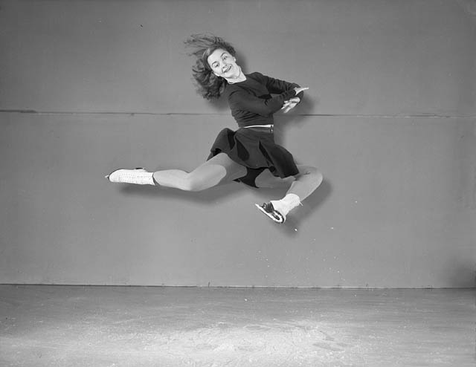
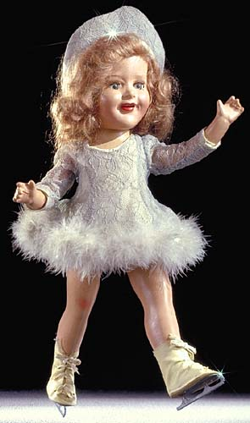
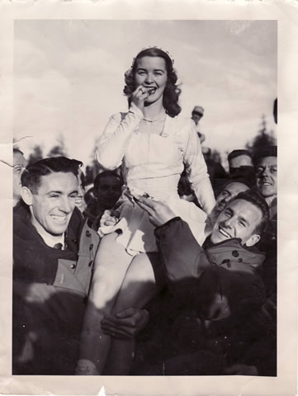
Barbara Ann Scott:
Famous figure skater in late 40s early 50s. In 1948 her win at the Olympics (first Canadian singles skater to win internationally) was more celebrated than the win of the hockey team.
- She became a famous celebrity (dolls were made of her, parades in her honours, given a car from the government).
- Was the ‘perfect’ woman: sweet, kind, quit when she married

Slide 4
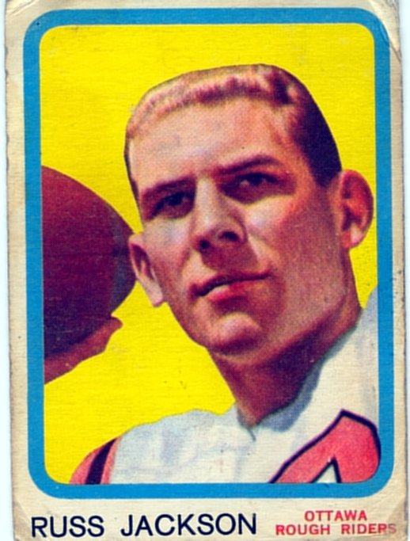
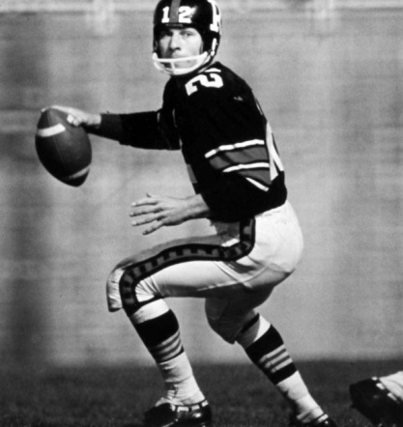
Russ Jackson:
- Considered (to this day) to be the best quarterback to ever play in the CFL
- Excelled at football and basketball, but 1958 decided to accept his draft to the Ottawa Rough Riders.
- Lead his team to 3 Grey Cups, and won the Schenley Award for Most Outstanding Player three times
- Canada showed their love by appointing him an Officer of the Order of Canada
recognizes people in all sectors of Canadian society. Their contributions are varied, yet they have all enriched the lives of others and made a difference to this country. The Order of Canada’s motto is DESIDERANTES MELIOREM PATRIAM (They desire a better country).

Slide 5
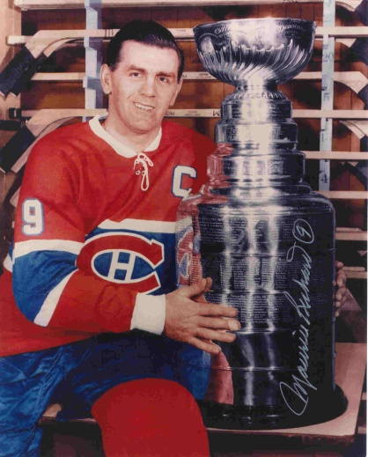
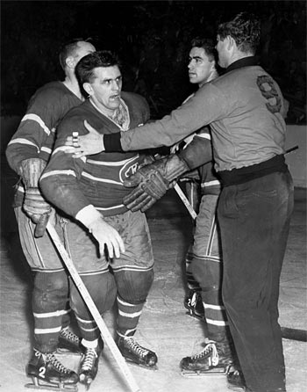
Maurice “the Rocket” Richard:
- Started his NHL career in 1940s and retired in 1960.
- By the time Richard retired he owned 17 NHL records and eight Stanley Cup Championships.
- After an intense fight, Richard was suspended for the remainder of the regular season and the playoffs. The decision enraged fans in Montreal, resulting in what came to be known as "The Richard Riot",
one of the most notorious events the hockey world has ever seen.

Slide 6
MUSIC
There was a variety of music in the 1950s
Music was an important part element in the emergence of the youth culture
Rock and Roll emerged for the first time (influenced by blues and other African-American ‘slave’ music).

Slide 7
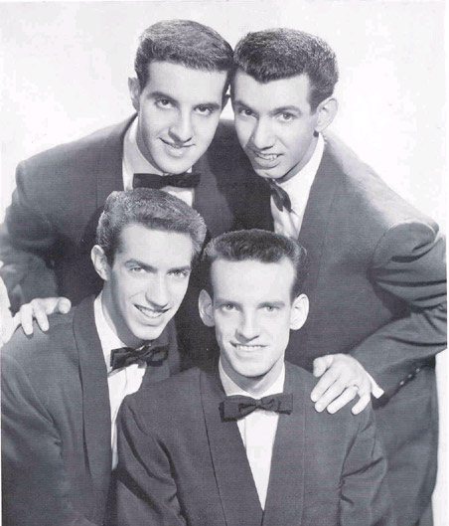
Canadians contributed to rock-and-roll, the Crew Cuts are credited with recording the first rock-and-roll song to sell a million copies.
Rock-and-roll was a radical separation from contemporary music of the adults (parents reacted harshly to this rebellious music).
Rock-and-Roll was heavily criticized as promoting immorality and delinquency among youth.---“communist ploy to destroy the free world”
The more protested the music, the more it was loved (adult music was ‘square’ and rock-and-roll was “cool”)

Slide 8
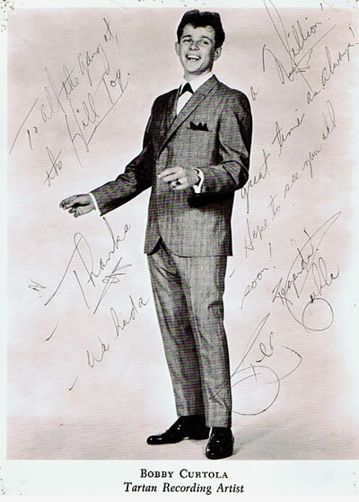
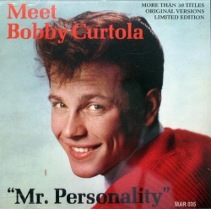
Bobby Curtola (Thunder Bay) became a teen idol, his clean cut music made him famous through the 50s and 60s.
Canadian artists were measured by their ability to crack the American music charts.

Slide 9
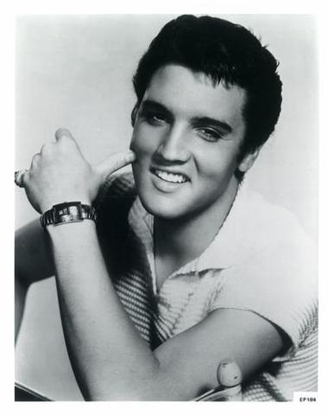
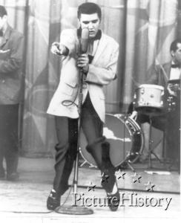
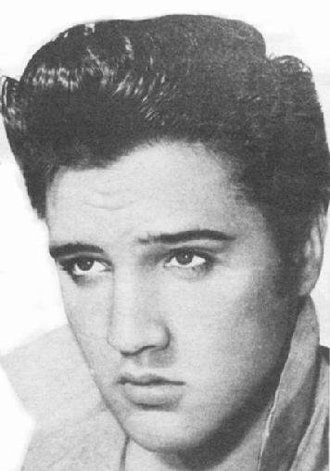
1956- Elvis Presley with a new sound and style, he challenged the social and racial barriers of the time, he ushered in a whole new era of music and popular culture.
1960s went from single acts to rock bands

